Slide 1

. PG-DAC March 2023 C-DAC IACSD, Akurdi, Pune

Slide 2
INTRODUCTION
In a world where emergencies and disasters can strike unexpectedly, having a reliable system for managing these situations is crucial. The Emergency Rescue Operation System, or EROS, is a web-based application designed to help people handle emergencies better.
This document outlines what EROS can do and what's needed to build it. It's like a blueprint for creating a powerful tool that will make it easier for authorities and emergency responders to manage crises and accidents.
EROS uses modern technology, like Spring Boot and ReactJS, to make it user-friendly and accessible to everyone. It simplifies tasks like reporting incidents, sorting them into categories, and communicating quickly during emergencies.
This document will explain how EROS manages users, helps report incidents, categorizes them, and keeps everyone informed in real-time. It also ensures the system is secure, reliable, and easy to use.
EROS is here to make emergencies easier to handle, so communities and organizations can keep people safe and minimize damage when disaster strikes.

Slide 3
We used Java Spring-Boot as backend and React JS as Frontend in our Project.
Spring-Boot :–
The main goal of the Spring Boot framework is to reduce overall development time and increase efficiency. React has become the first choice for frontend because it gives developers the ability to work with a virtual browser (more friendly than the real browser). Also, a JavaScript developer can become a productive developer in a few hours because there is a small API to learn, a few functions, and how to use them…
React :–
React allows developers to create large web applications that can change data, without reloading the page. The main purpose of React is to be fast, scalable, and simple. Spring

Slide 4
Features: -
Administrator: Manages user accounts, resources, and system configuration.
Emergency Responder: Reports incidents, allocates resources, and updates incident statuses.
Regular User: Reports incidents, receives notifications, and views incident updates.

Slide 5
Adminstrator:
User Account Management:
Create, maintain, and deactivate user accounts for personnel involved in the emergency rescue operation. This includes medical staff, rescue teams, and administrative personnel.
Assign appropriate permissions and access levels to each user based on their roles and responsibilities.
Ensure secure and controlled access to sensitive information and resources.
Resource Management:
Inventory, track, and manage all critical resources required for medical emergency response, including medical supplies, equipment, and vehicles.
Implement a system for resource allocation and distribution to ensure they are available where and when needed during emergency situations.
Regularly update the resource database to reflect current stock levels and expiration dates.
System Configuration:
Configure and maintain the emergency response system, including communication channels, databases, and software tools.
Implement and update standard operating procedures (SOPs) for the system, ensuring they align with best practices and safety guidelines.

Slide 6
Emergency Responder:
Incident Reporting:
Act as the first point of contact for receiving reports of medical emergencies from the public, medical personnel, or other sources.
Gather essential information about the incident, including location, type of emergency, and the number of individuals affected.
Verify the accuracy of information received and assess the severity of the situation.
Resource Allocation:
Determine the necessary resources, such as medical personnel, equipment, and vehicles, required to respond to each reported incident.
Prioritize incidents based on their urgency and allocate resources accordingly.
Incident Status Updates:
Maintain a real-time record of incident statuses, including response times, resource deployment, and any developments on the ground.
Communicate incident updates to relevant parties, including medical teams, administrative staff, and local authorities.
Coordinate with field personnel to ensure accurate and up-to-date information is available at all times.
Resource Coordination:
Collaborate closely with the Emergency Rescue Operation Administrator and other key stakeholders to optimize the allocation of resources.
Monitor the availability of critical resources, such as medical supplies, and request additional resources as needed.

Slide 7
Regular User:
Incident Reporting:
Act as a proactive observer in the community and promptly report any medical emergencies or incidents to the designated emergency response system.
Provide accurate and detailed information about the incident, including location, nature of the emergency, and any potential hazards.
Receiving Notifications:
Be prepared to receive notifications and updates from the emergency response system regarding ongoing incidents in the area.
Stay attentive to alerts and messages sent by the system and be ready to respond as needed.
Viewing Incident Updates:
Access the emergency response system to view real-time incident updates, including response status, estimated arrival times, and any safety instructions.
Stay informed about the progress of incidents and any additional resources or actions required.

Slide 8
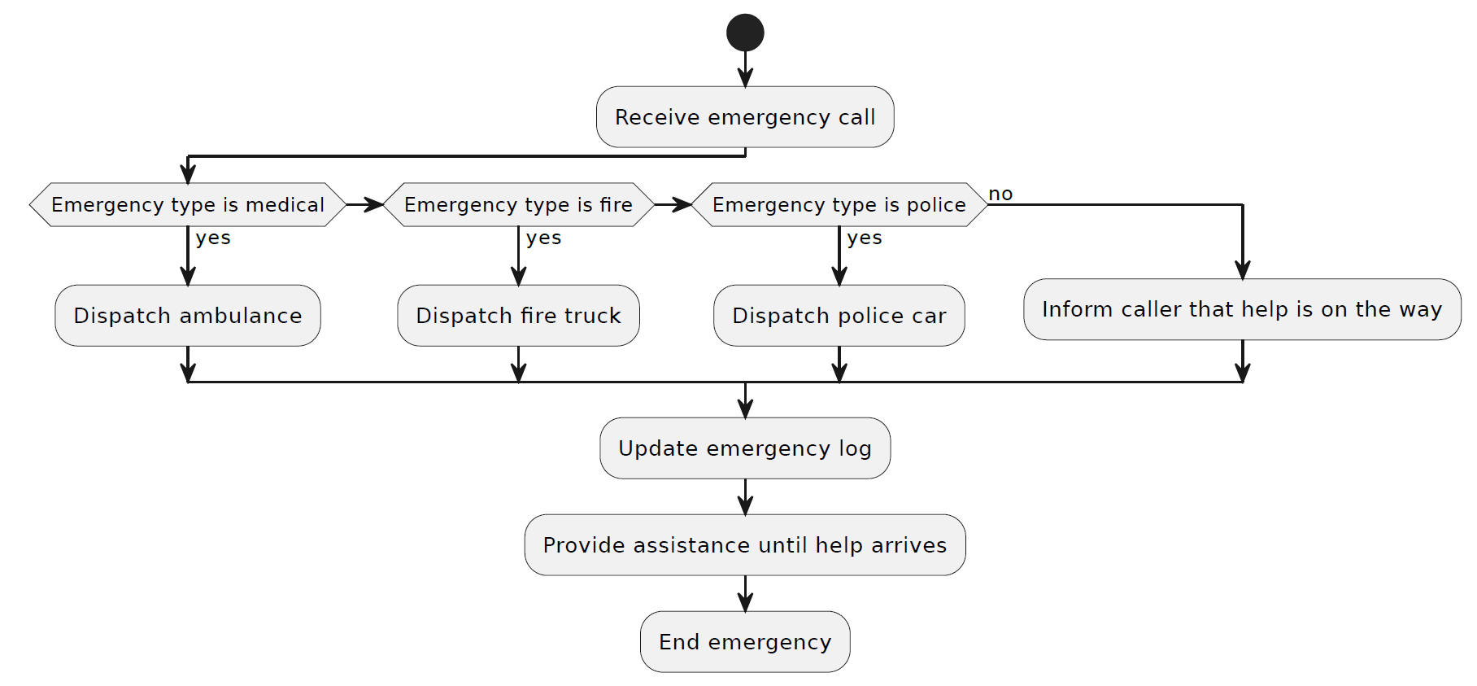
Activity Diagram:

Slide 9
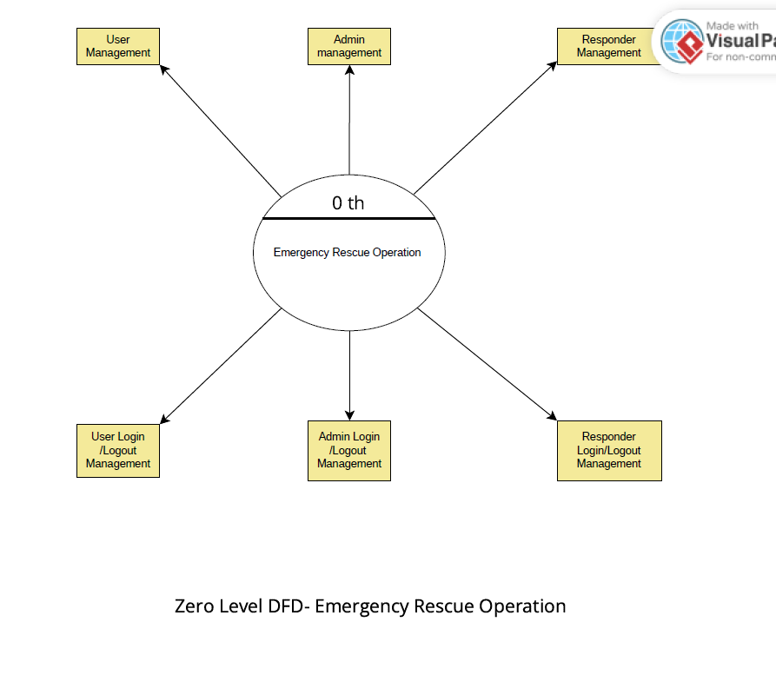
Zero Level DF Diagram:

Slide 10
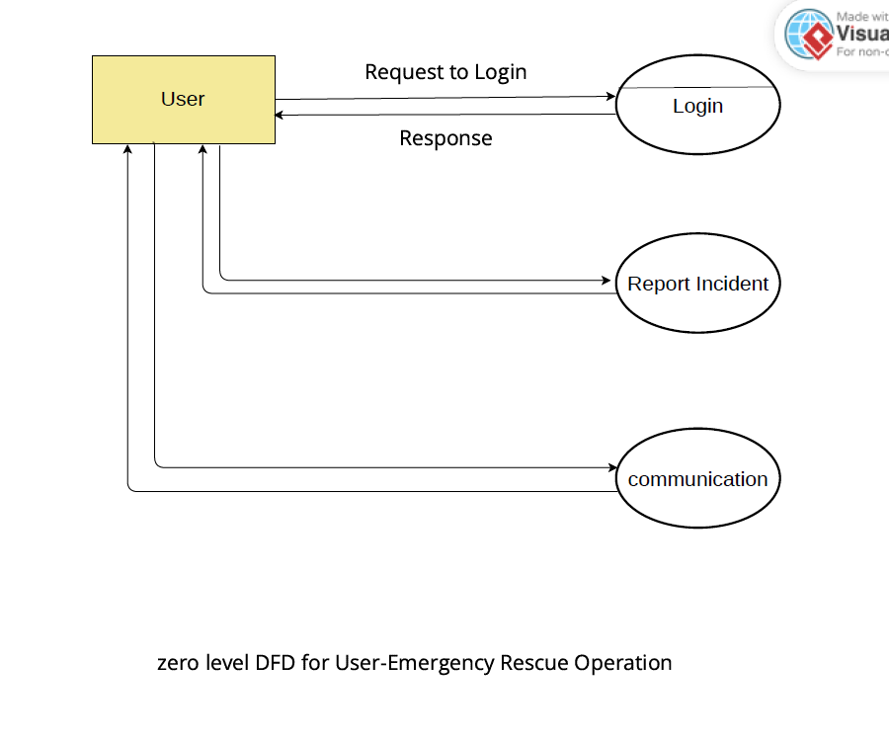
Zero Level Diagram For User:

Slide 11
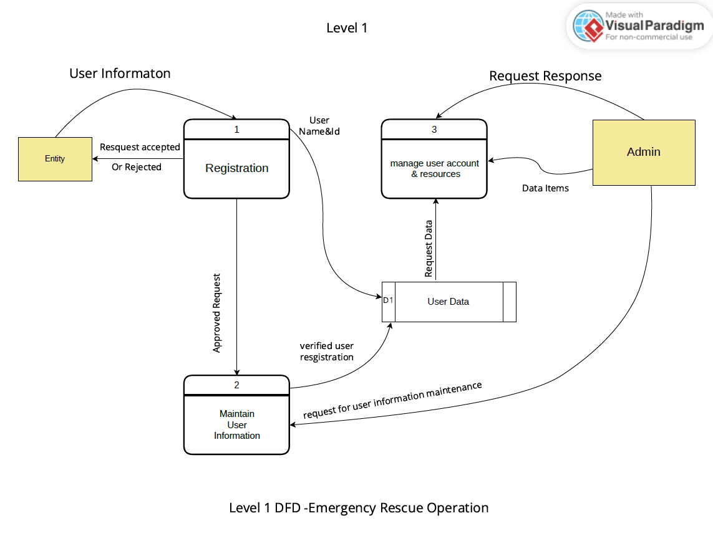
Level 1 Diagram :

Slide 12
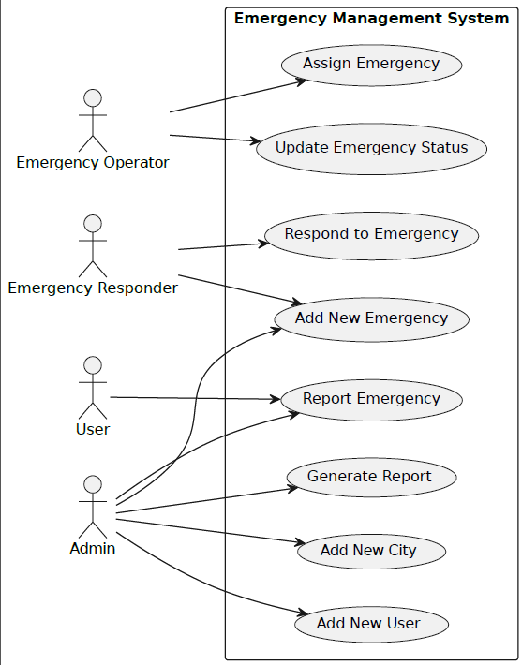
Use case Diagram:

Slide 13
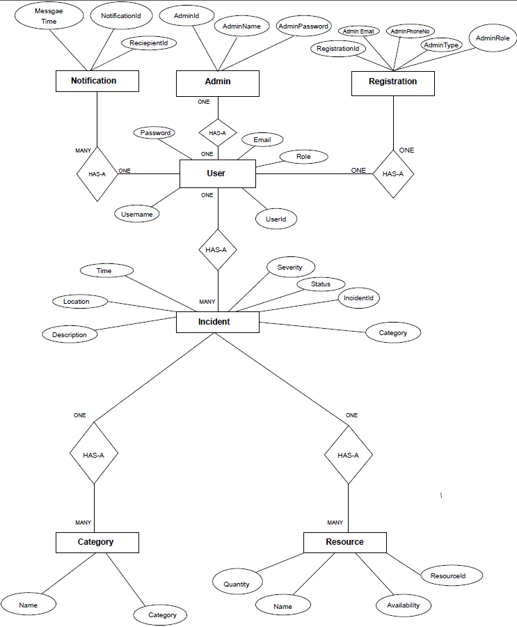
ER Diagram :

Slide 14
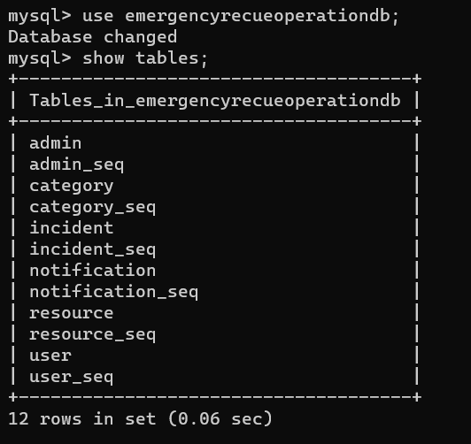

TABLE STRUCTURE:
Tables:
Category:

Slide 15
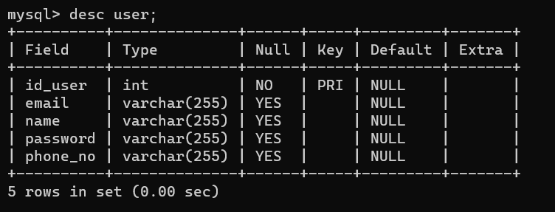
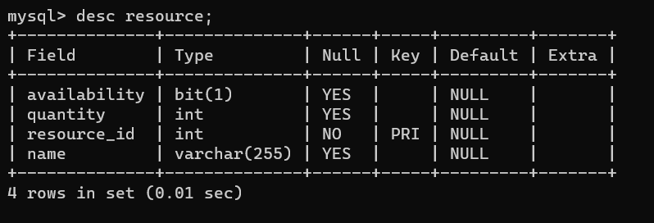
User:
Resources:

Slide 16
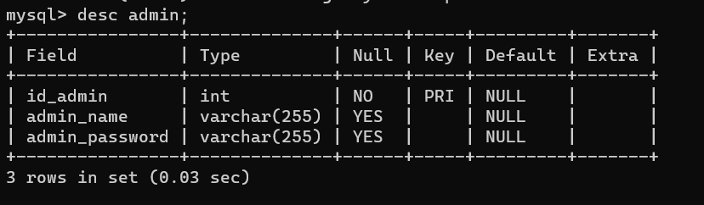
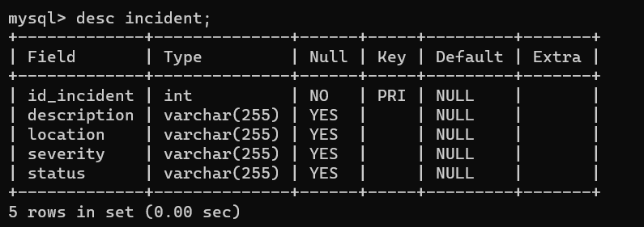
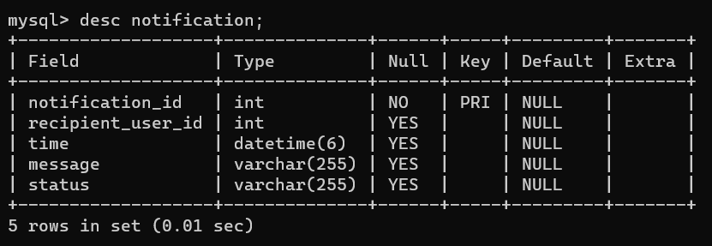
Admin:
Incident:
Notification:

Slide 17
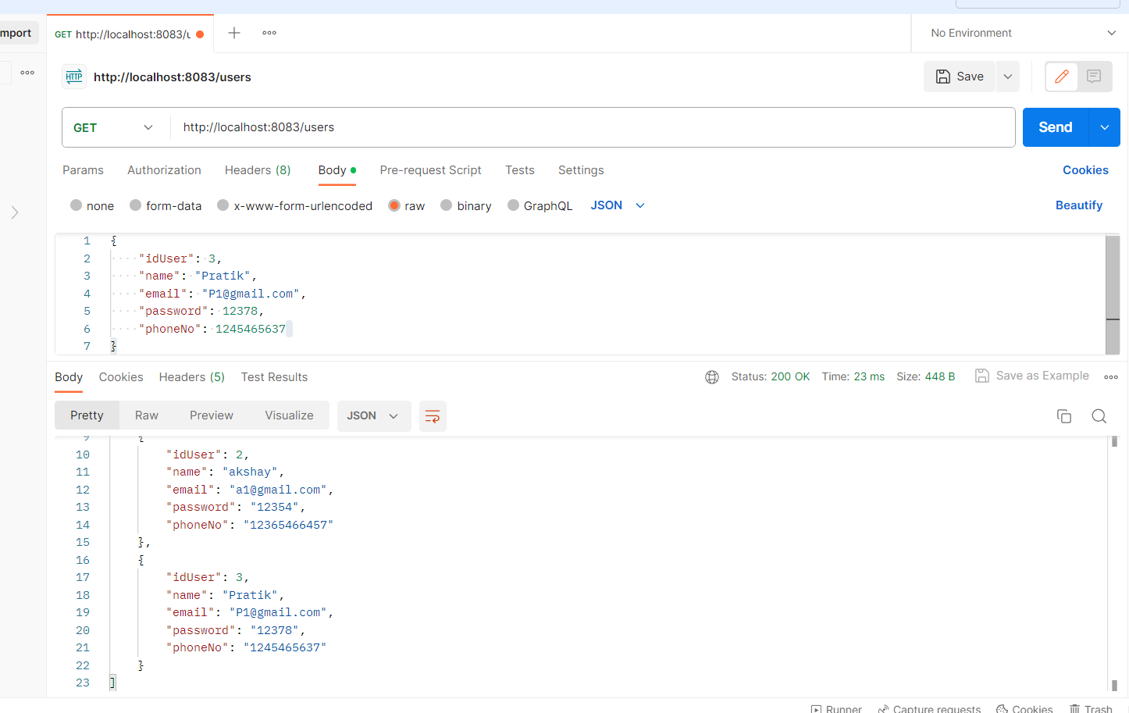
Postman:

Slide 18
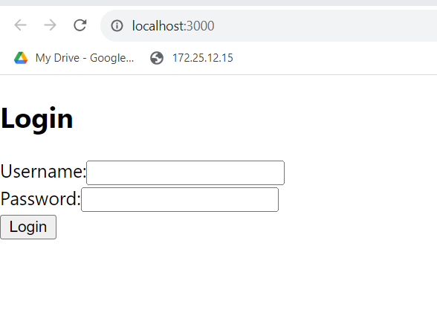
Login In:

Slide 19
Thank you
Shubham D. Sandhan
shubhamsandhan82@gmail.com
Github:https://github.com/shubhamsandhanpatil/CDAC_Project.git

